Slide 1
Seattle Colleges FY1920 Operating Budget Review
September 2019

Slide 2
The Board approved the FY1920 Seattle Colleges operating budget at the June 2019 Board meeting.
This update is provided to review the operating budget approved in June with adjustments made by colleges since that time.
Total budgeted expenses approved in June were $155.4M.
For this review, total budgeted expenses are $153.9M.

Slide 3
Seattle Central shows a larger share of allocation up $8.3M from last fiscal year. The new allocation model results in each college’s share of the State Board allocation reflected in College budgets with District expenses being allocated to colleges.
Tuition and running start revenue is budgeted to be nearly even with last year’s actual tuition and international is budgeted down $1.1M from last year’s actual revenue.
Budgeted Salaries and Benefits combined increase 7%.
Other expenses are $4.3M higher than the previous year budget which include Central’s share of District Expenses.

Slide 4
North Seattle College’s allocation increases $7M over last year. Tuition is budgeted to increase $451K over last year’s actuals and running start is budgeted to increase $652K over last year’s actuals. International revenue is budgeted to decrease by $323K from last year’s actuals.
Salaries combined with benefits are budgeted to increase 3% over last year’s budget.
Other expenses are $4.5M higher than last year’s budget and include District expenses.

Slide 5
South Seattle College’s allocation increases $6.7M from last year.
Tuition is budgeted to decrease $687K from last year’s actuals, Running Start revenues are budgeted to be nearly even with last year’s revenue and international revenue is budgeted to decline by $1.5M over last year’s actuals.
Salaries and benefits combined are budgeted to decrease 5% from last year’s budget.
Other expenses are budgeted to increase by $5.2M over last year’s budget including District expenses.

Slide 6
The new allocation model results in a transfer of most District expenses to colleges. Budgeted expenses show increases from prior years due to ASI efforts like moving IT related expense to District from colleges.
Salaries and benefits budgeted at District increase $3.7M over last year’s budgeted expenses.
Other expenses, prior to transfer of expenses to colleges, decrease by $146K over last year’s budget.

Slide 7
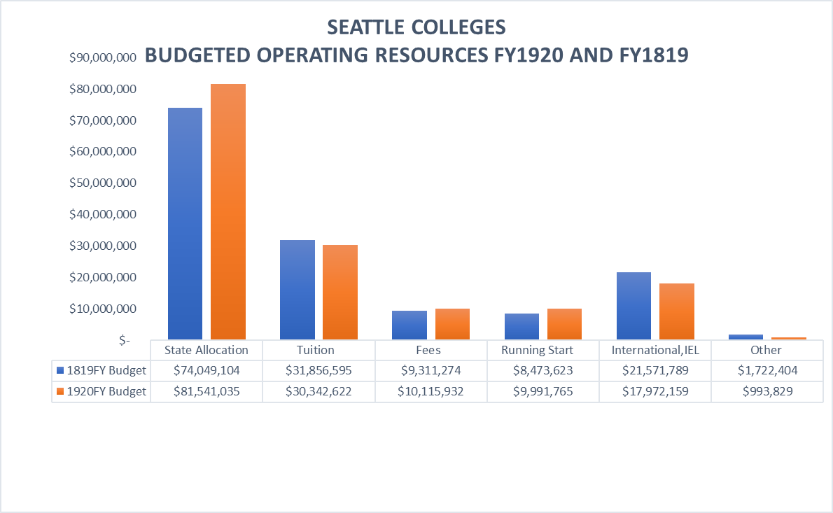

Slide 8
